Slide 1
GEM: Multilingual graph-to-text generation
NPFL140: LLMs
LLMFAO:
Thomas Goumont, Melvin Bazeille, Vojtech John,
Kassem Anis Bouali, Romita Pawar and Ines Ben Moussa
Supervised by Ondrej Dusek

Slide 2

GEM: Multilingual graph-to-text generation
NPFL140: LLMs
LLMFAO:
Thomas Goumont, Melvin Bazeille, Vojtech John,
Kassem Anis Bouali, Romita Pawar and Ines Ben Moussa
Supervised by Ondrej Dusek

Slide 3
GEM: Graph-to-text generation
NPFL140: LLMs
LLMFAO:
Thomas Goumont, Melvin Bazeille, Vojtech John,
Kassem Anis Bouali, Romita Pawar and Ines Ben Moussa
Supervised by Ondrej Dusek

Slide 4
Introduction

Slide 5
Introduction
In recent years, graph-to-text generation has emerged as a critical task in natural language generation (NLG), enabling the transformation of structured data into coherent, fluent text. This becomes increasingly complex and relevant when scaled to multilingual settings, where language-specific nuances must be considered alongside semantic accuracy.
This project explores multilingual graph-to-text generation using large language models (LLMs), evaluating their capacity to generalize across languages and structures within the GEM (Generation Evaluation Metrics) benchmark. We investigate different architectures and training protocols to assess how well LLMs can understand and verbalize graph-structured information in multiple languages.
Our work contributes to a better understanding of how multilingual LLMs can be aligned with graph inputs, addressing both the scalability and adaptability of these models in cross-linguistic contexts. Through comprehensive validation, we aim to highlight key insights, challenges, and future directions for multilingual NLG from structured knowledge.
Introduction

Slide 6
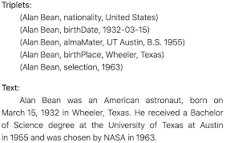
Task setting
Input: a small knowledge graph (resp. triplets)
Task: generate text accurately representing the graph
Dataset: WebNLG
English to English
13K training triplets
Evaluation
Translation metrics (least bad)
BLEU for validation + BertScore for test

Slide 7
Methodology

Slide 8
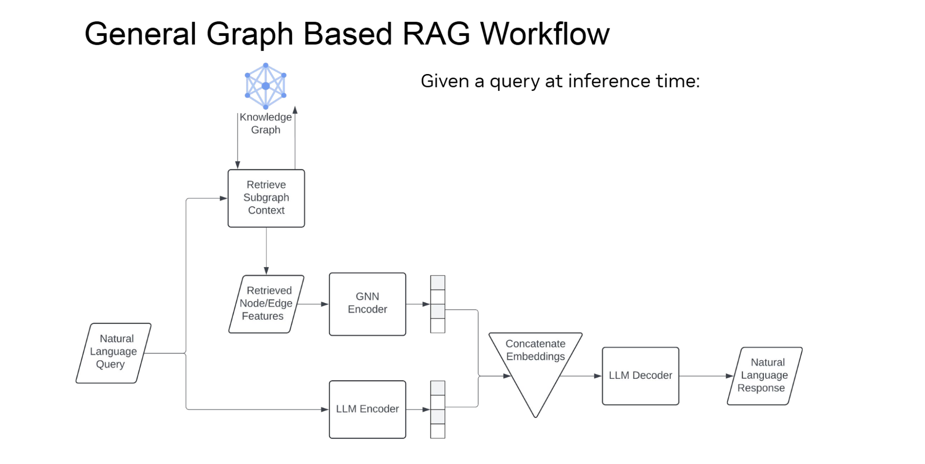

Model Architecture

Slide 9
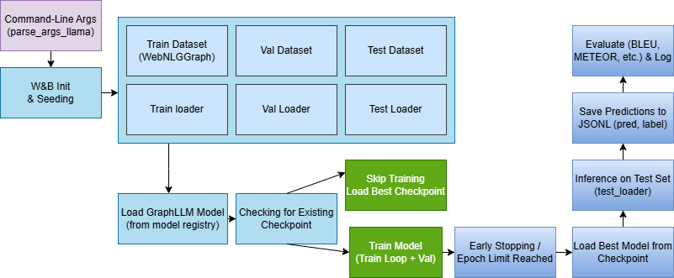
Training Protocol
Workflow

Slide 10
Results

Slide 11
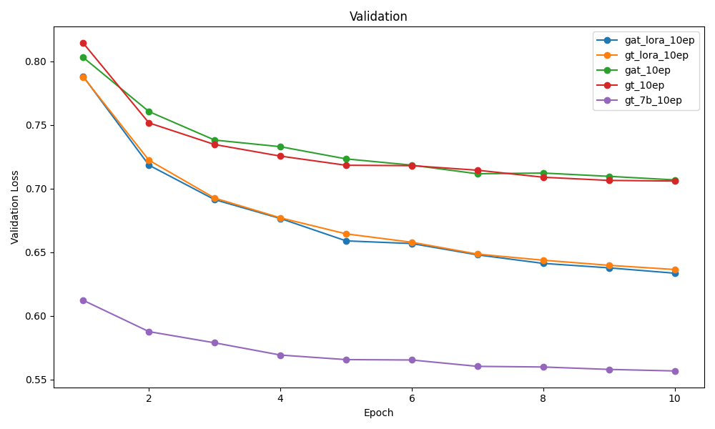
Results
Validation

Slide 12
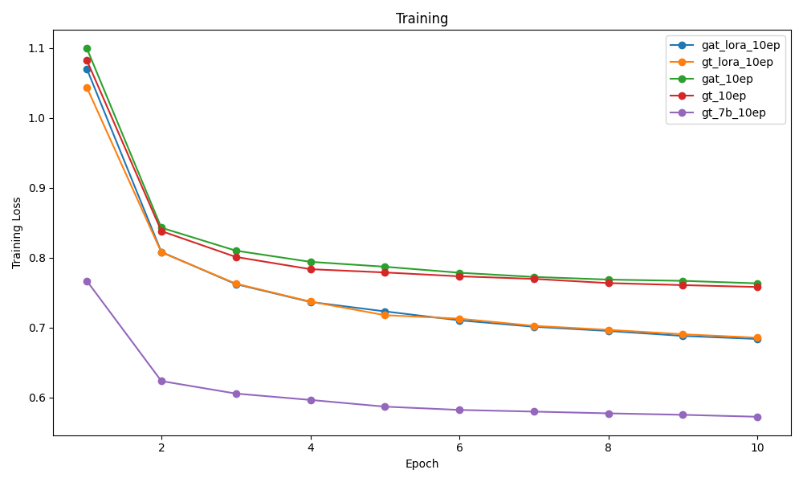
Results
Training

Slide 13
Results
Subject | Predicate | Object
Estádio Municipal Coaracy da Mata Fonseca | location | Arapiraca
Agremiação Sportiva Arapiraquense | league | Campeonato Brasileiro Série C
Campeonato Brasileiro Série C | country | Brazil
Agremiação Sportiva Arapiraquense | nickname | Alvinegro
Agremiação Sportiva Arapiraquense | ground | Estádio Municipal Coaracy da Mata Fonseca
Qualitative

Slide 14
Results
Text References (Ground Truth Sentences) –input- | Prediction –output-
- Estádio Municipal Coaracy da Mata Fonseca is the name of the ground of Agremiação Sportiva Arapiraquense in Arapiraca. - Agremiação Sportiva Arapiraquense, nicknamed Alvinegro, lay in the Campeonato Brasileiro Série C league from Brazil. - Estádio Municipal Coaracy da Mata Fonseca is the name of the ground of Agremiação Sportiva Arapiraquense in Arapiraca. Alvinegro, the nickname of Agremiação Sportiva Arapiraquense, play in the Campeonato Brasileiro Série C league from Brazil. | The Agremiação Sportiva Arapiraquense plays in the Campeonato Brasileiro Série C league in Brazil. The ground of the club is the Estádio Municipal Coaracy da Mata Fonseca located in Arapiraca. The team is called Alvinegro.
Qualitative

Slide 15
Evaluation
validation metrics: BLEU
test metrics: ExactMatch, BLEU, Bertscore (i.e. cosine distance od BERT embeddings)
Very similar results across models
 | Exact match | BLEU | BERT score
LLAMA tiny | 0.049 | 48.48 | 0.952
LLAMA 2-7b | 0.063 | 49.95 | 0.958
Graph - gat_lora | 0.053 | 47.69 | 0.954
Graph - gt_lora | 0.056 | 48.70 | 0.954
Graph - gt | 0.056 | 47.02 | 0.951
Graph - gat | 0.052 | 46.08 | 0.952

Slide 16
References
1. Hu et al. (2024) Hu, Y., Lei, Z., Zhang, Z., Pan, B., Ling, C., & Zhao, L. (2024). GRAG: Graph Retrieval-Augmented Generation. arXiv. https://arxiv.org/abs/2405.16506
2. Moussallem (2020) Moussallem, D. (2020). Knowledge Graphs for Multilingual Language Translation and Generation. arXiv. https://arxiv.org/abs/2009.07715
3. Han & Gardent (2023) Han, K., & Gardent, C. (2023). Multilingual Generation and Answering of Questions from Texts and Knowledge Graphs. In Proceedings of the Conference on Empirical Methods in Natural Language Processing. https://arxiv.org/abs/266166029
4. Zhu et al. (2024) Zhu, Y., Wang, Y., Shi, H., & Tang, S. (2024). Efficient Tuning and Inference for Large Language Models on Textual Graphs. arXiv. https://arxiv.org/abs/2401.15569
5. Guo et al. (2024) Guo, K., Liu, Z., Chen, Z., Wen, H., Jin, W., Tang, J., & Chang, Y. (2024). Learning on Graphs with Large Language Models (LLMs): A Deep Dive into Model Robustness. arXiv. https://arxiv.org/abs/2407.12068
6. Colas et al. (2022) Colas, A., Alvandipour, M., & Wang, D. Z. (2022). GAP: A Graph-aware Language Model Framework for Knowledge Graph-to-Text Generation. In International Conference on Computational Linguistics. https://arxiv.org/abs/248177721
7. Zhu et al. (2025) Zhu, X., Xue, H., Zhao, Z., Xu, W., Huang, J., Guo, M., Wang, Q., Zhou, K., & Zhang, Y. (2025). LLM as GNN: Graph Vocabulary Learning for Text-Attributed Graph Foundation Models. arXiv. https://arxiv.org/abs/2503.03313
8. Yu et al. (2024) Yu, Z., Xu, X., & Gao, H. (2024). G2T-LLM: Graph-to-Tree Text Encoding for Molecule Generation with Fine-Tuned Large Language Models. arXiv. https://arxiv.org/abs/2410.02198
9. Chen et al. (2025) Chen, H., Wang, X., Zhang, Z., Li, H., Wen, W., Feng, L., & Zhu, W. (2025). Curriculum GNN-LLM Alignment for Text-Attributed Graphs. OpenReview. https://openreview.net/forum?id=tmwR707odU
10. Ribeiro et al. (2020) Ribeiro, L. F. R., Schmitt, M., Schütze, H., & Gurevych, I. (2020). Investigating Pretrained Language Models for Graph-to-Text Generation. arXiv. https://arxiv.org/abs/2007.08426
11. He et al. (2025) He, J., Yang, Y., Long, W., Xiong, D., Gutierrez-Basulto, V., & Pan, J. Z. (2025). Evaluating and Improving Graph to Text Generation with Large Language Models. arXiv. https://arxiv.org/abs/2501.14497

Slide 17
Conclusion
This template is not as tremendous as the LaTeX one
But it looks at least similar
Don’t be lazy, rather use LaTeX with Beamer

